Slide 1
Northrop Grumman:
Secure State Estimation
HMC Team:
Robert Cyprus (S)
Aishvarya Korde (S)
Zayra Lobo (J)
Paige Rinnert (Fall TL)
Advisor: Professor Chris Clark
Liaisons: Ken Dreshfield ‘80
Ian Jimenez ‘11
Ron P. Smith ‘83
Stephanie Tsuei (Lead)

Slide 2
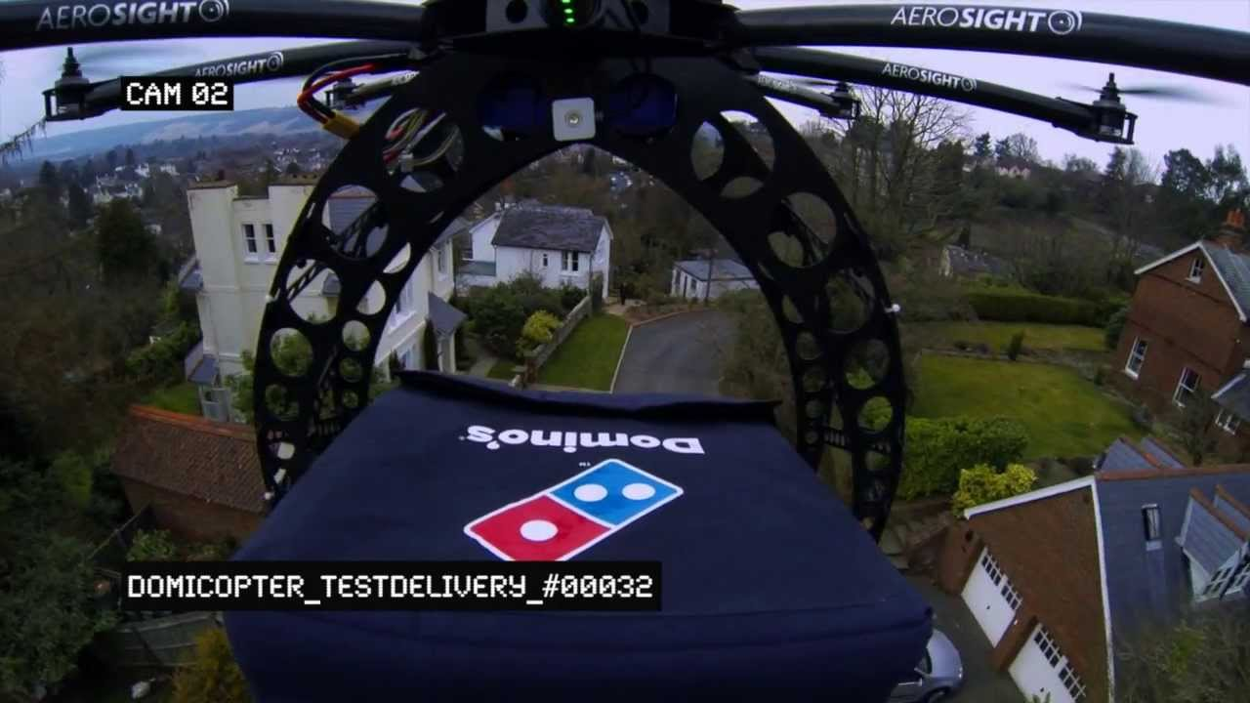
https://www.youtube.com/watch?v=on4DRTUvst0

Slide 3
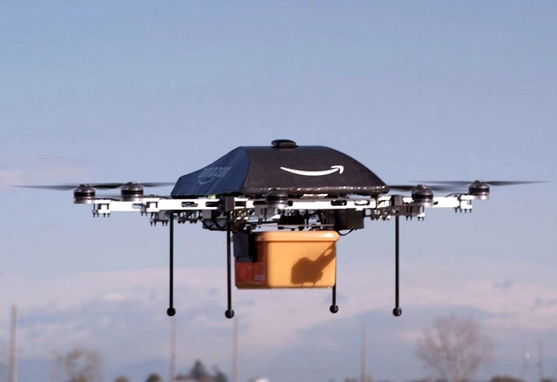
http://inhabitat.com/jeremy-clarkson-introduces-amazons-prime-air-drone-delivery-in-charming-video/
https://www.youtube.com/watch?v=on4DRTUvst0

Slide 4
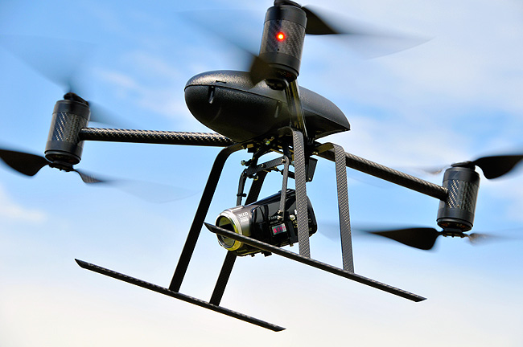
http://eijournal.com/news/industry-insights-trends/north-dakota-cops-embrace-surveillance-drones
http://inhabitat.com/jeremy-clarkson-introduces-amazons-prime-air-drone-delivery-in-charming-video/
https://www.youtube.com/watch?v=on4DRTUvst0

Slide 5
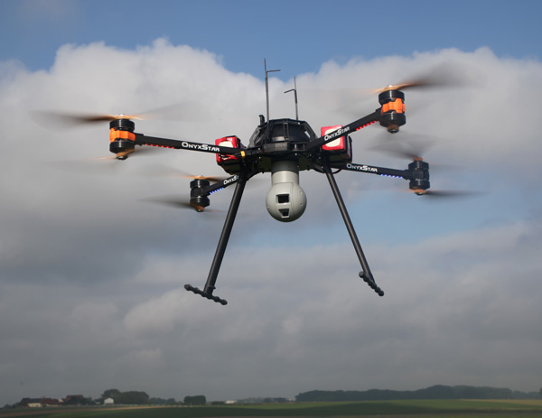
Overview
Project Description
Simulation
Hardware
Current Progress
Questions
https://en.wikipedia.org/wiki/Quadcopter

Slide 6


Project Statement
The Northrop Grumman Clinic Team will implement a secure state estimator in software and then experimentally validate the estimator in hardware. The team will demonstrate that the addition of the SSE algorithm to the control loop reduces the real-time tracking error of a quadrotor when using measurements from compromised onboard sensors.
Notes:
Show quadrotors and maybe not the logos – make sure not to read these slides

Slide 7
Project Statement
The Northrop Grumman Clinic Team will implement a secure state estimator in software and then experimentally validate the estimator in hardware. The team will demonstrate that the addition of the SSE algorithm to the control loop reduces the real-time tracking error of a quadrotor when using measurements from compromised onboard sensors.
Notes:
Show quadrotors and maybe not the logos – make sure not to read these slides

Slide 8
Project Statement
The Northrop Grumman Clinic Team will implement a secure state estimator in software and then experimentally validate the estimator in hardware. The team will demonstrate that the addition of the SSE algorithm to the control loop reduces the real-time tracking error of a quadrotor when using measurements from compromised onboard sensors.
Notes:
Show quadrotors and maybe not the logos – make sure not to read these slides

Slide 9
Project Statement
The Northrop Grumman Clinic Team will implement a secure state estimator in software and then experimentally validate the estimator in hardware. The team will demonstrate that the addition of the SSE algorithm to the control loop reduces the real-time tracking error of a quadrotor when using measurements from compromised onboard sensors.
Notes:
Show quadrotors and maybe not the logos – make sure not to read these slides

Slide 10
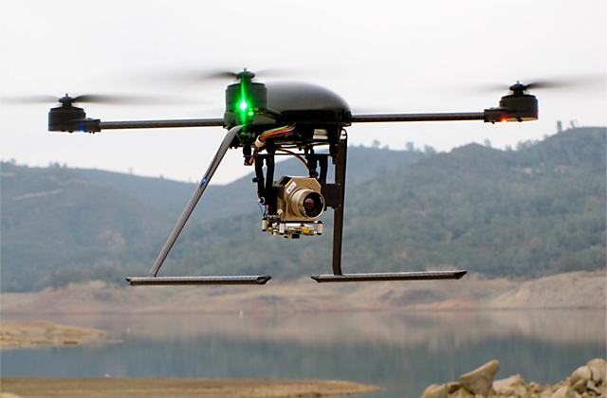
Objectives
Control quadrotor with minimal altitude tracking error [m]
Maximize number of compromised sensors for which states can be estimated
Minimize cost
http://illumin.usc.edu/162/the-quadrotors-coming-of-age/
Notes:
Make a picture of UAV trying to maintain altitude

Slide 11
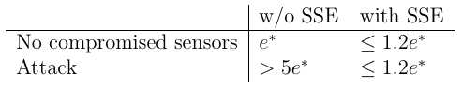
Constraints
SSE must reduce tracking error when sensors are compromised:
Final implementation of the SSE must be in ROS
Quadrotor must fly for 10 minutes on a single battery charge
Must estimate states at a frequency of at least 25 Hz
Notes:
Next presentation: add visual to explain e*

Slide 12
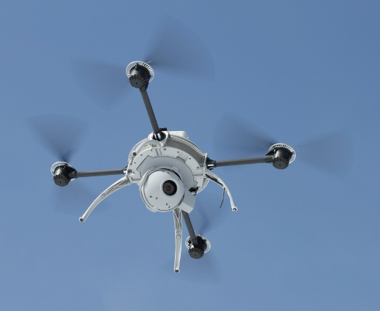
Functions
The SSE should estimate the states of the quadrotor
Complete pre-planned altitude profile with compromised sensors
Perform real time state estimation and correction
Simulate hacking of sensor inputs to the SSE
http://spectrum.ieee.org/automaton/robotics/military-robots/aeryon-scout-quadrotor-spies-on-bad-guys-from-above

Slide 13
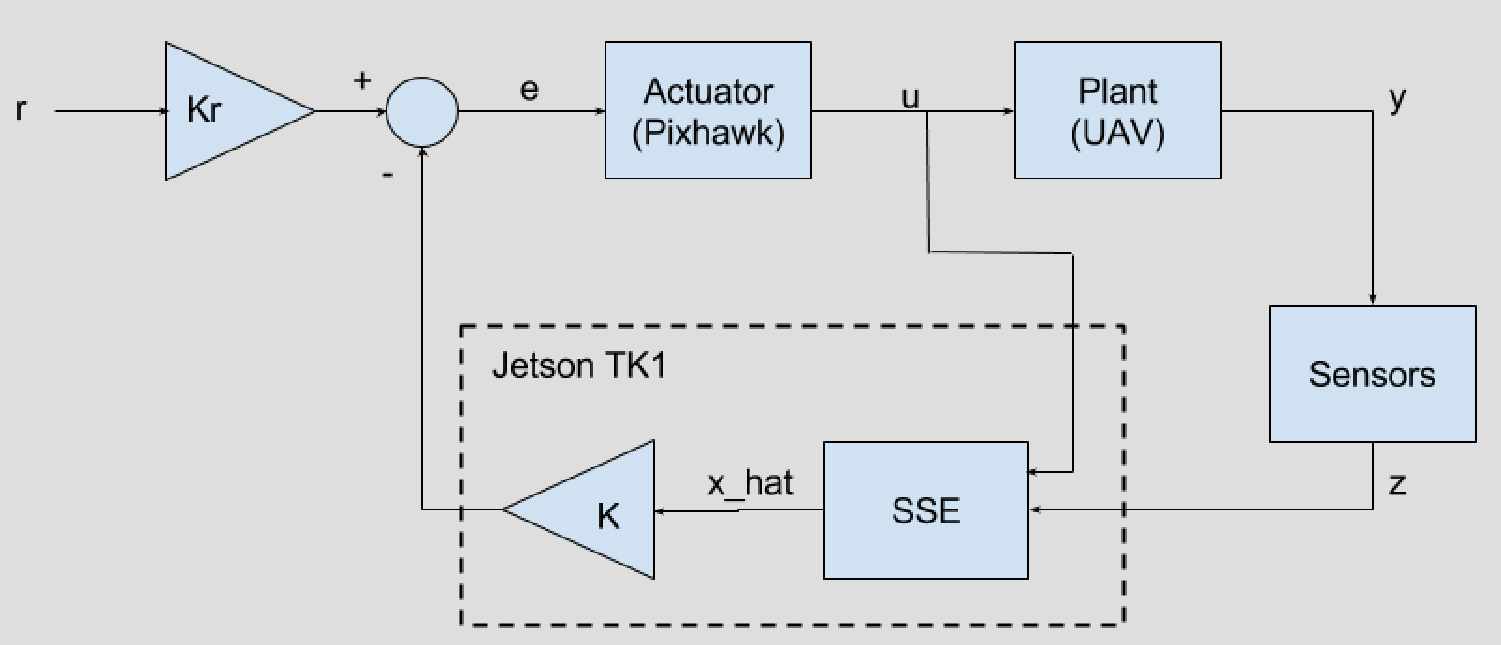
Preliminary Control System Outline
Notes:
Transition – recap the problem statement and big picture (same with Robert on trans to hardware)

Slide 14
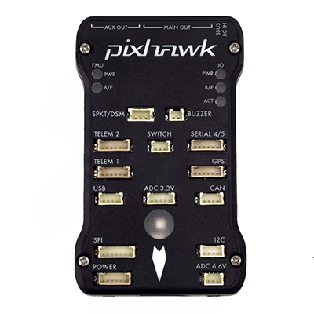
Preliminary Control System Outline
Notes:
Transition – recap the problem statement and big picture (same with Robert on trans to hardware)

Slide 15
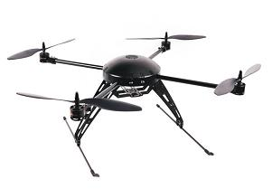
Preliminary Control System Outline
http://www.pupin.rs/RnDProfile/research-topic28.html
Notes:
Transition – recap the problem statement and big picture (same with Robert on trans to hardware)

Slide 16
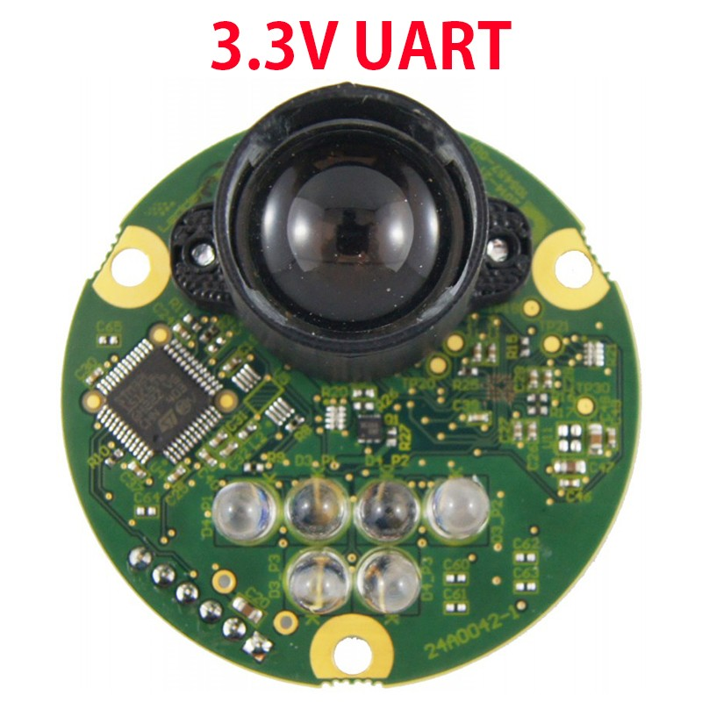
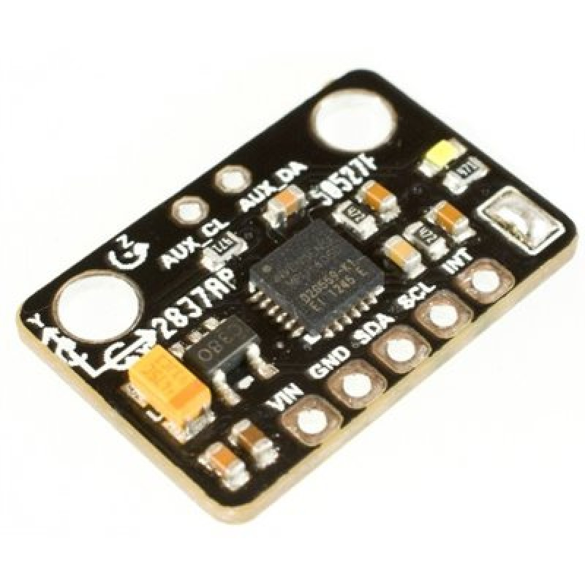
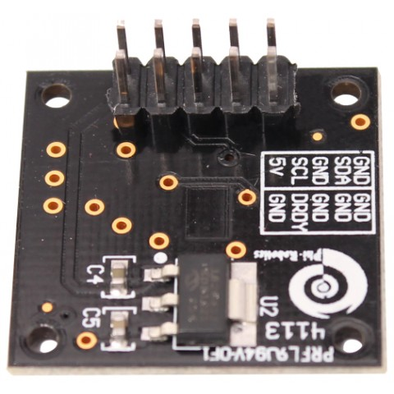
Preliminary Control System Outline
Notes:
Transition – recap the problem statement and big picture (same with Robert on trans to hardware)

Slide 17
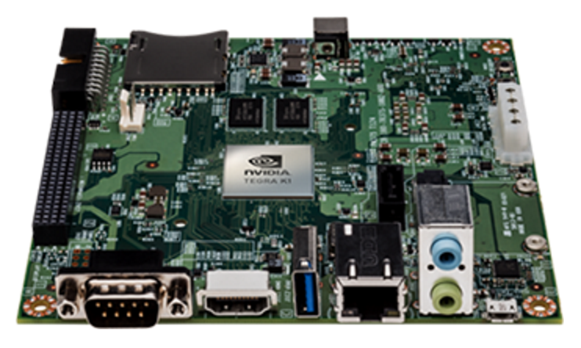
Preliminary Control System Outline
http://www.pupin.rs/RnDProfile/research-topic28.html
Notes:
Transition – recap the problem statement and big picture (same with Robert on trans to hardware)

Slide 18
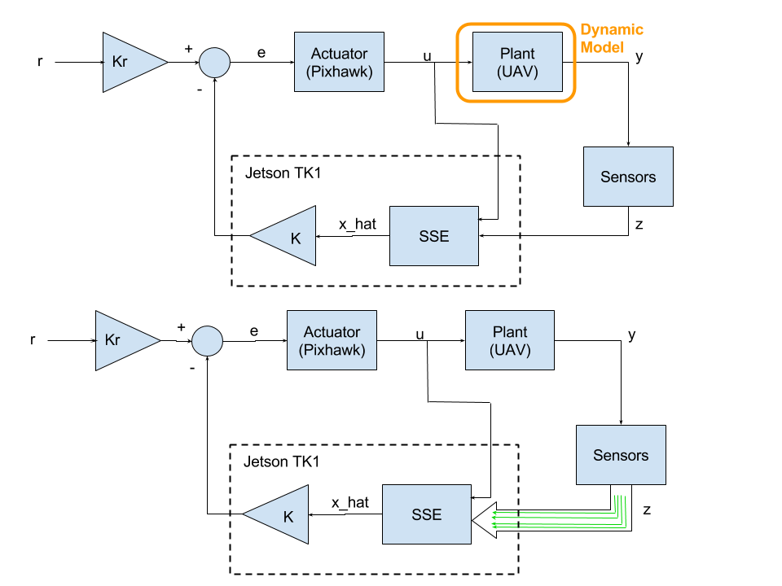
Preliminary Control System Outline
Functioning Sensors

Slide 19
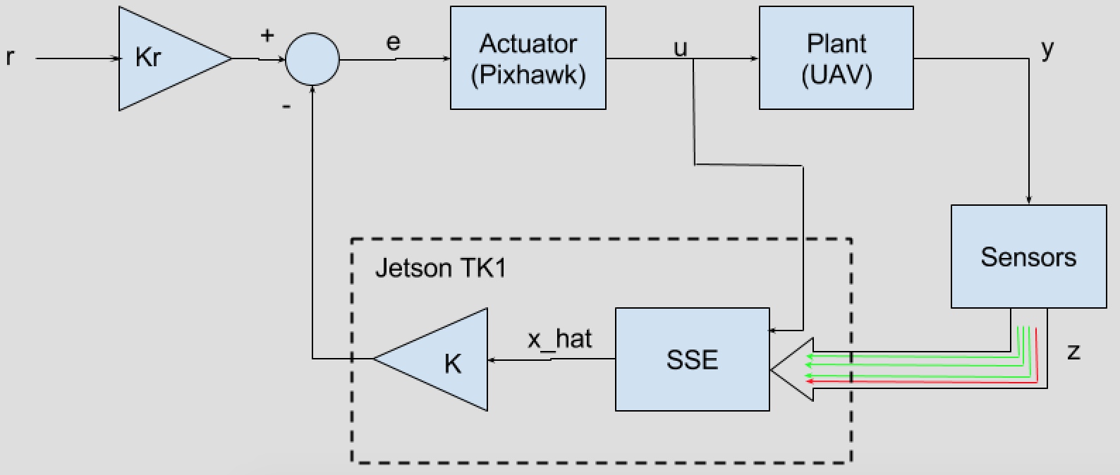
Preliminary Control System Outline
Functioning Sensors
Compromised Sensors

Slide 20
Preliminary Control System Outline
Dynamic Model
http://www.pupin.rs/RnDProfile/research-topic28.html
Notes:
Transition – recap the problem statement and big picture (same with Robert on trans to hardware)

Slide 21
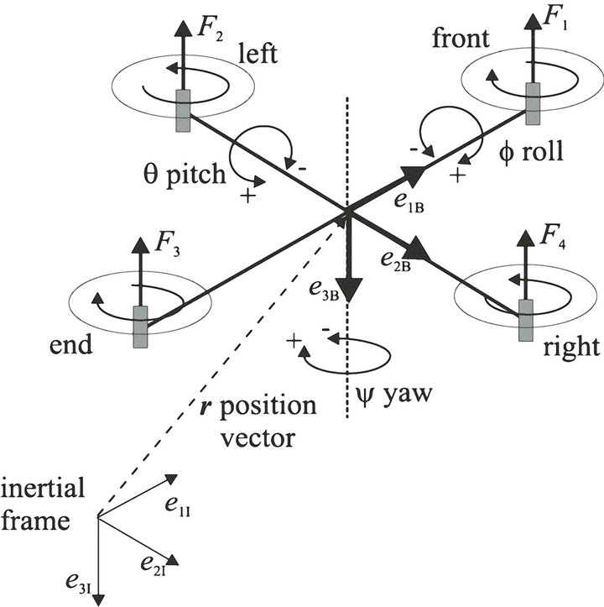
Quadrotor Dynamic Model: Coordinate Definitions
Body frame
http://file.scirp.org/Html/12-7900231_35654.htm
Notes:
Transition again, talk about big picture, then get into the details
We need a dynamic model to test a simulator
Split into multiple slides
Possibly an intro slide set, before the problem statement

Slide 22
Quadrotor Dynamic Model: Coordinate Definitions
http://file.scirp.org/Html/12-7900231_35654.htm
Notes:
Transition again, talk about big picture, then get into the details
We need a dynamic model to test a simulator

Slide 23
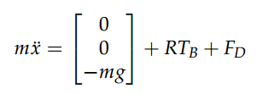
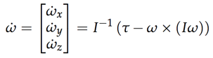
Dynamic Model
 | Thrust vector in body frame
 | Drag force
 | Rotation matrix (linear)
 | Inertia matrix
 | Torques in body frame
 | Angular velocity
 | Rotation matrix (rotational)
Linear Motion
Rotational Motion
http://andrew.gibiansky.com/downloads/pdf/Quadcopter%20Dynamics,%20Simulation,%20and%20Control.pdf

Slide 24
Preliminary Control System Outline: SSE
Optimization Algorithm

Slide 25
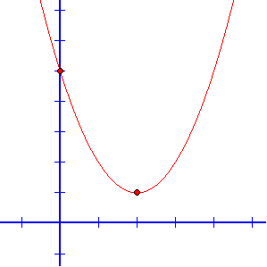
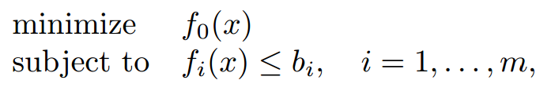
Convex Optimization
Solves special class of problems
Least-squares linear programming (LP)
Quadratic programming (QP)
Many solvers exist (e.g. CVX)
Fast solution time
Many applications
http://stanford.edu/~boyd/papers/pdf/rt_cvx_sig_proc.pdf
Notes:
Transition statement
Really tough to make interesting

Slide 26
Convex Optimization Example
Find the minimum of y(x)
y(x)
http://www.mesacc.edu/~scotz47781/mat120/notes/graph_quads/vertex_form/graph_quads_vertex_form.html
Notes:
Transition statement
Really tough to make interesting

Slide 27
Convex Optimization Example
Find the minimum of y(x)
y(x)
http://www.mesacc.edu/~scotz47781/mat120/notes/graph_quads/vertex_form/graph_quads_vertex_form.html
Notes:
Transition statement
Really tough to make interesting

Slide 28
Convex Optimization Example
Find the minimum of y(x) for x <= 0
y(x)
http://www.mesacc.edu/~scotz47781/mat120/notes/graph_quads/vertex_form/graph_quads_vertex_form.html
Notes:
Transition statement
Really tough to make interesting

Slide 29
Convex Optimization Example
Find the minimum of y(x) for x <= 0
y(x)
http://www.mesacc.edu/~scotz47781/mat120/notes/graph_quads/vertex_form/graph_quads_vertex_form.html
Notes:
Transition statement
Really tough to make interesting

Slide 30
Convex Optimization Example
Find the minimum of y(x) for x <= 0
objective constraint
http://www.mesacc.edu/~scotz47781/mat120/notes/graph_quads/vertex_form/graph_quads_vertex_form.html
Notes:
Transition statement
Really tough to make interesting

Slide 31
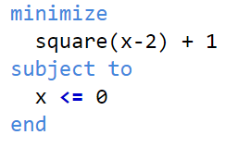
Convex Optimization Example
Find the minimum of y(x) for x <= 0
objective constraint
http://www.mesacc.edu/~scotz47781/mat120/notes/graph_quads/vertex_form/graph_quads_vertex_form.html
Notes:
Transition statement
Really tough to make interesting

Slide 32
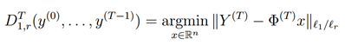
SSE Optimization Algorithm
Goal:
Find states that minimize the difference between predicted outputs and sensor outputs subject to constraints on the states
Hamza Fawzi, Paulo Tabuada, Suhas Diggavi, Secure estimation and control for cyber-physical systems under adversarial attacks
https://arxiv.org/pdf/1205.5073v1.pdf

Slide 33
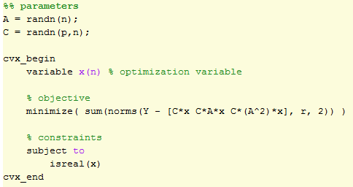
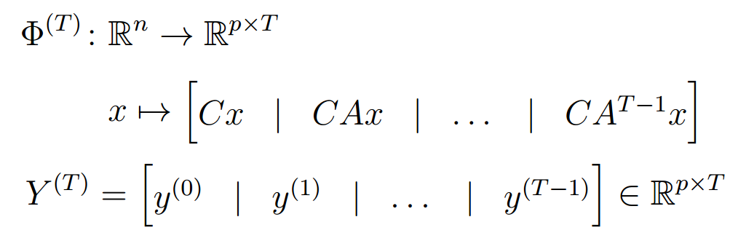
SSE Optimization Algorithm
Mathematical representation:
CVX code:
Currently implementing SSE algorithm in Matlab
Plan to generate solver code to interface with the quadrotor
Hamza Fawzi, Paulo Tabuada, Suhas Diggavi, Secure estimation and control for cyber-physical systems under adversarial attacks
https://arxiv.org/pdf/1205.5073v1.pdf

Slide 34
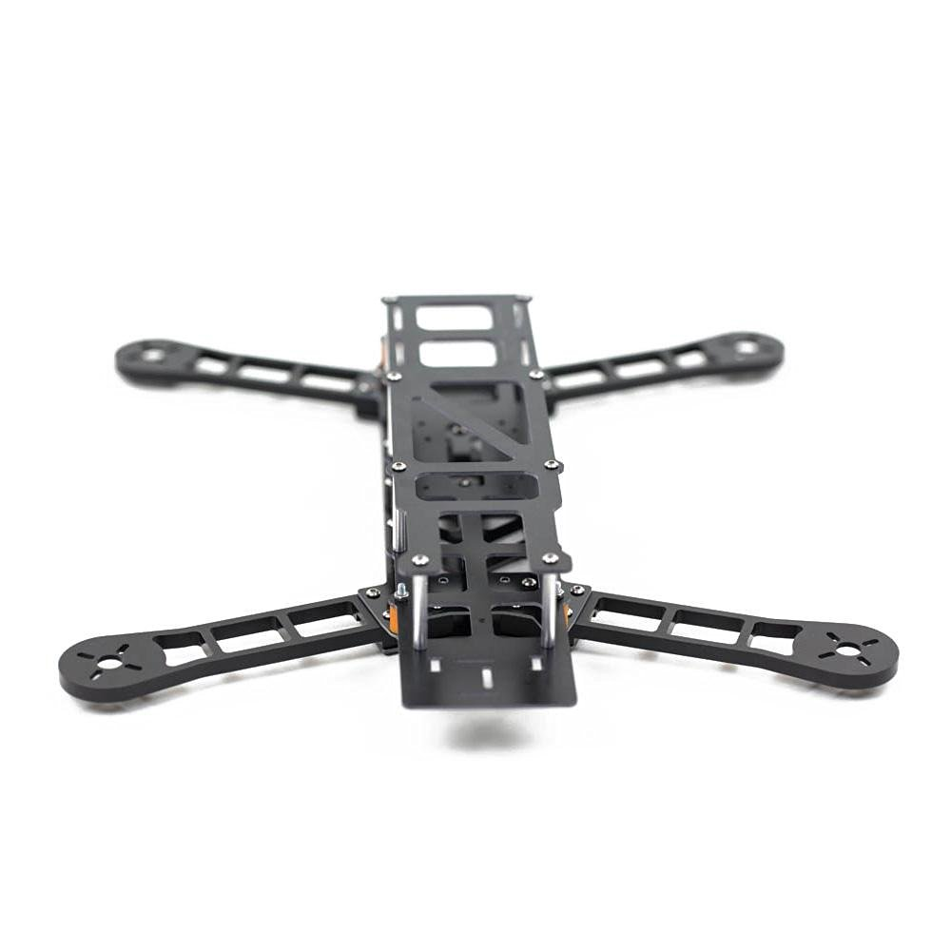
Hardware: Quadrotor and Control
Onboard computer
Jetson TK1 board
Flight controller
3DR Pixhawk
Quadrotor frame
QAV400
Lightweight
Easily customizable
http://www.nvidia.com/object/jetson-tk1-embedded-dev-kit.html
http://www.desertaircraft.com.au/shop/qav400-fpv-quadcopter-frame-arf.html
http://www.hover-bike.com/MA/product/pixhawk/

Slide 35
Hardware: Sensors
3-DOF Orientation & Angular Velocity
Compass
Gyroscopes
3-DOF Position & Velocity
Accelerometers
Laser Range Finder
OptiTrack vision system
Notes:
Transition statement
Draw pictures of UAV with sensors on it

Slide 36
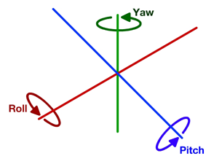
Hardware: Sensors
3-DOF Orientation & Angular Velocity
Compass
Gyroscopes
3-DOF Position & Velocity
Accelerometers
Laser Range Finder
OptiTrack vision system
Compass
http://theboredengineers.com/2012/05/the-quadcopter-basics/
Notes:
Transition statement
Draw pictures of UAV with sensors on it

Slide 37
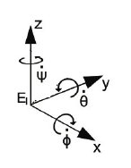
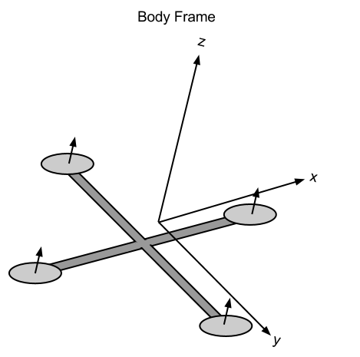
Hardware: Sensors
3-DOF Orientation & Angular Velocity
Compass
Gyroscopes
3-DOF Position & Velocity
Accelerometers
Laser Range Finder
OptiTrack vision system
IMU (3 accelerometers & 3 gyroscopes)
http://andrew.gibiansky.com/blog/physics/quadcopter-dynamics/
https://www.researchgate.net/figure/270163654_fig1_Fig-1-Inertial-and-body-fixed-frame-of-quadrotor
Notes:
Transition statement
Draw pictures of UAV with sensors on it

Slide 38
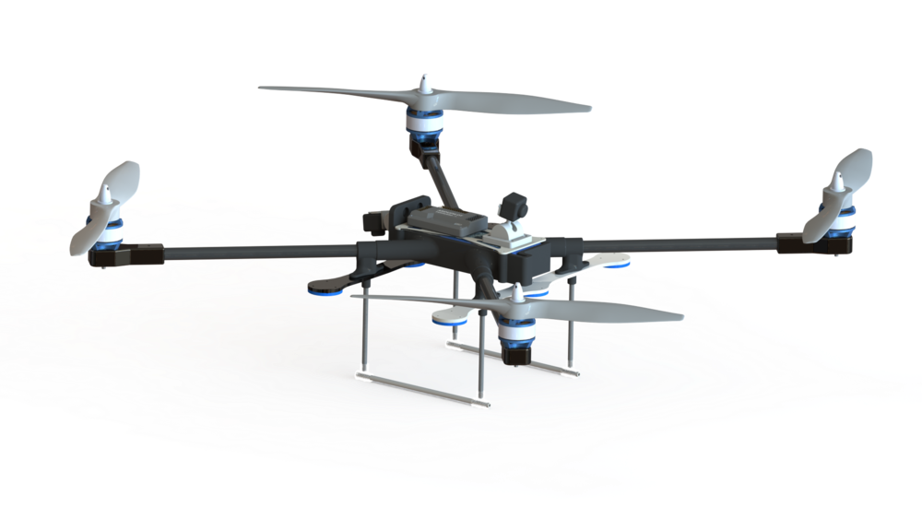
Hardware: Sensors
3-DOF Orientation & Angular Velocity
Compass
Gyroscopes
3-DOF Position & Velocity
Accelerometers
Laser Range Finder
OptiTrack vision system
Height (z)
Laser Range Finder
http://www.gabrielle-merritt.com/herald/
Notes:
Transition statement
Draw pictures of UAV with sensors on it

Slide 39
Hardware: Sensors
3-DOF Orientation & Angular Velocity
Compass
Gyroscopes
3-DOF Position & Velocity
Accelerometers
Laser Range Finder
OptiTrack vision system
Notes:
Transition statement
Draw pictures of UAV with sensors on it

Slide 40
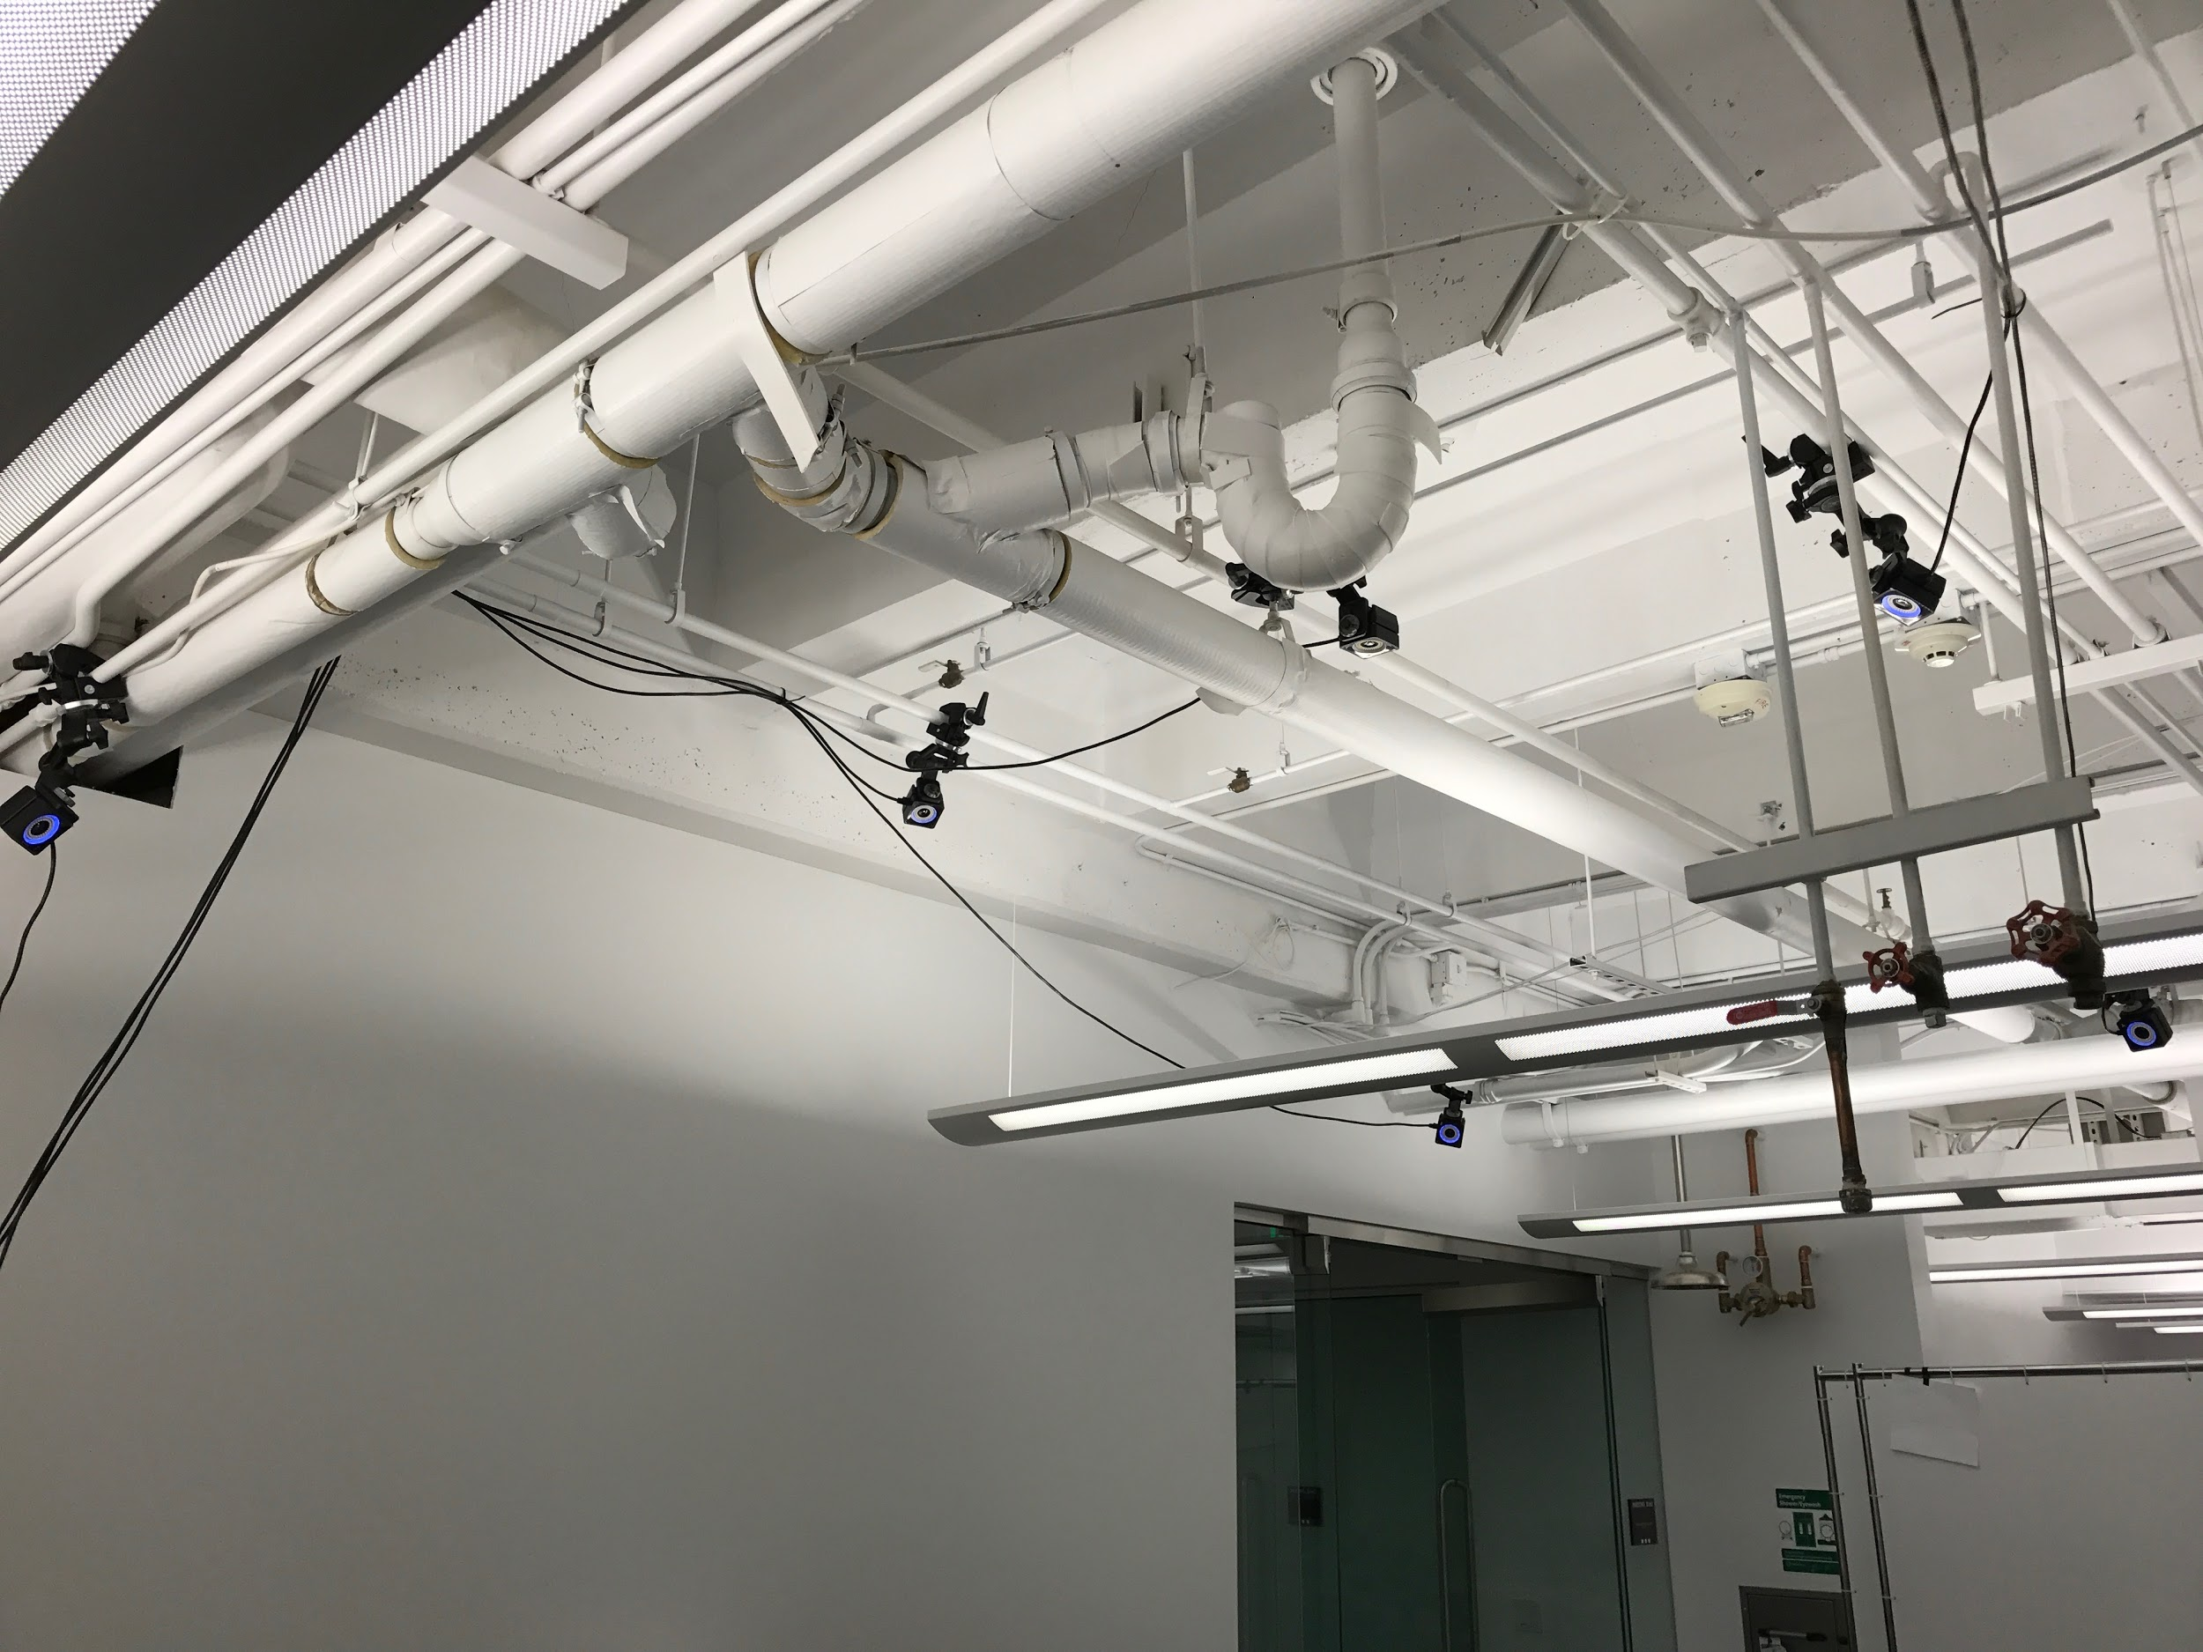
Optitrack Motive: Camera Positions

Slide 41
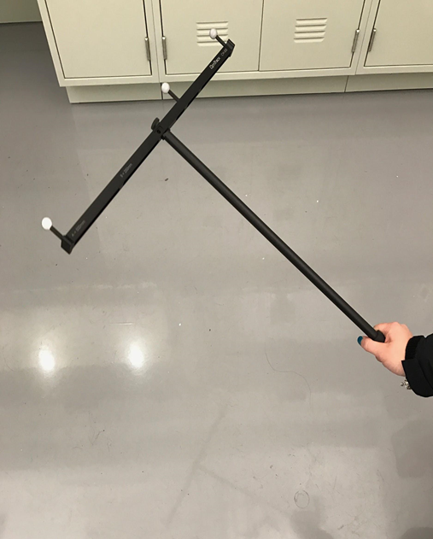
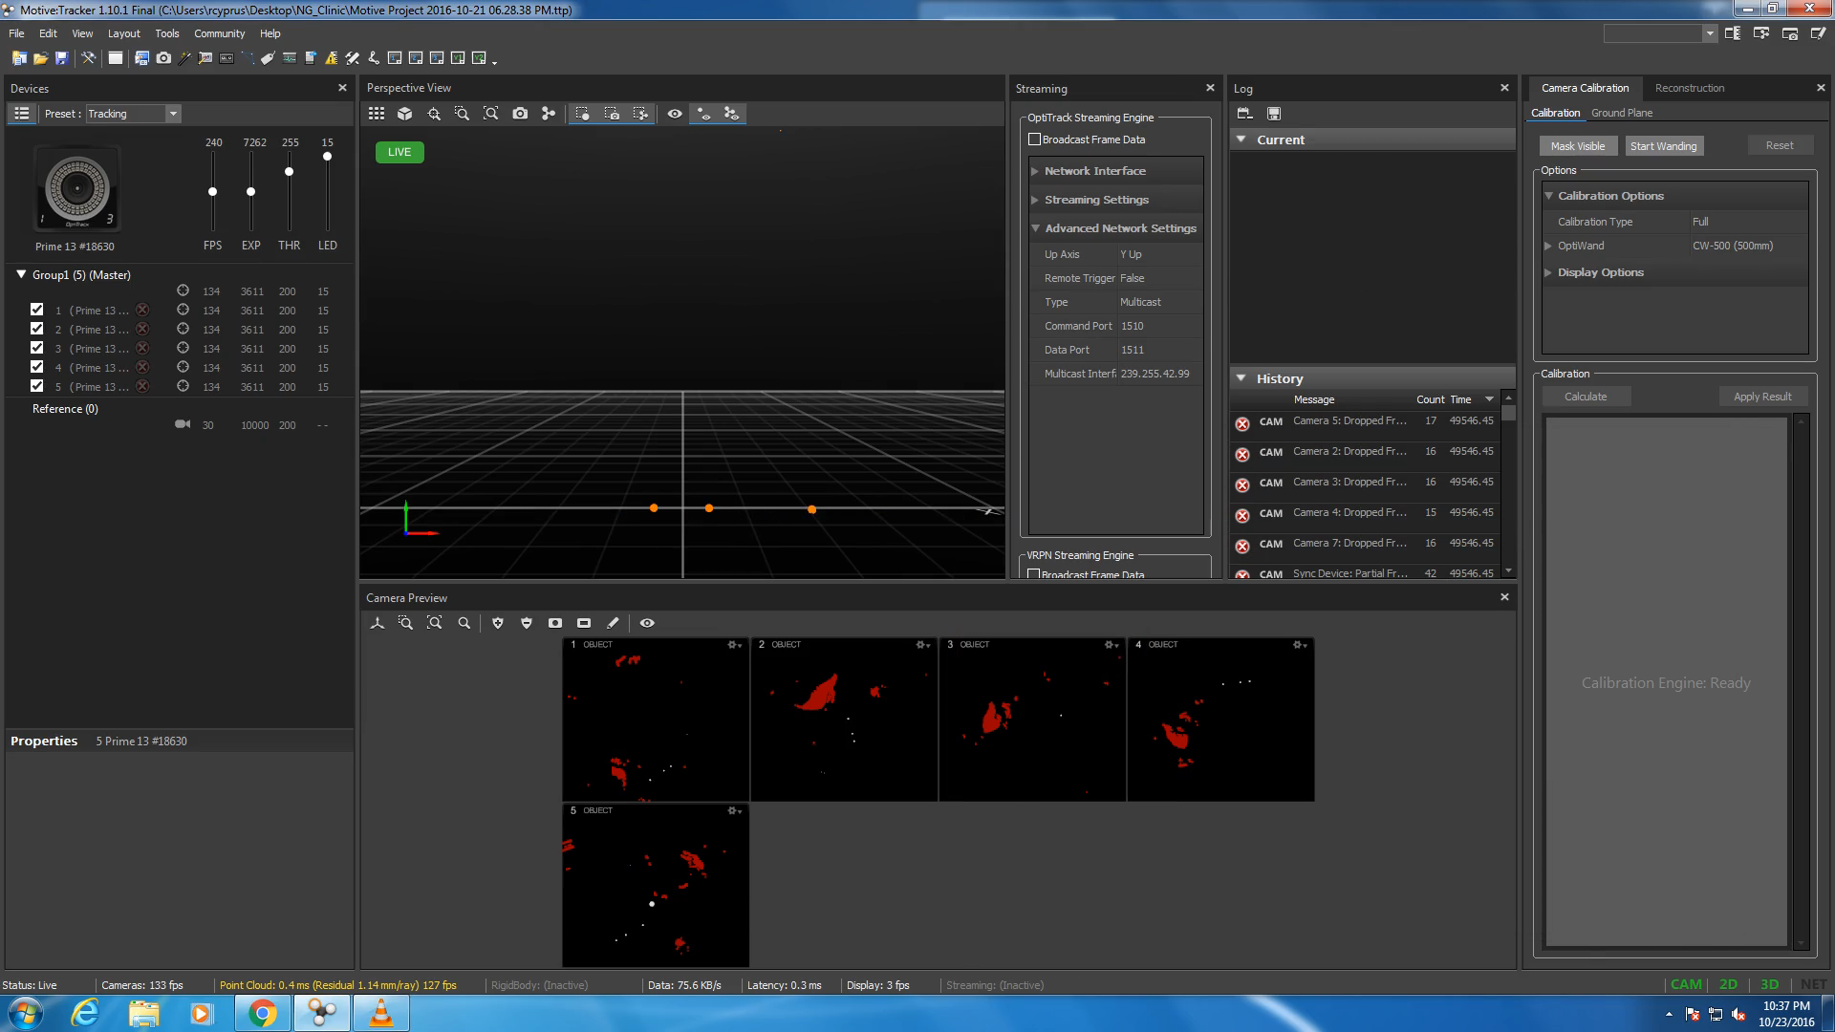
Optitrack System: Example Tracking
Notes:
Tell them what to expect before playing the video

Slide 42
Current Progress and Short Term Goals
Current progress
Setup and calibrated OptiTrack vision system
Completed workplan
Purchased controller, onboard computer and sensors
Short-term goals
Quadrotor dynamic model simulation
Continue to code SSE algorithm in Matlab
Purchase quadrotor
Calibrate sensors and test controller
Notes:
Add a plot or pic

Slide 43
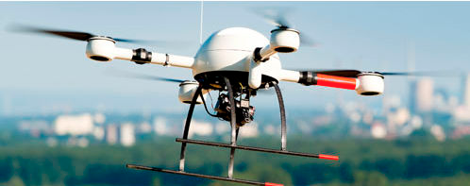
Deliverables
Fall Semester
Implement and simulate a state estimator in Matlab
All sensors functioning
Some sensors compromised
Successfully log sensor data
Produce a functioning quadrotor with onboard computer, controller, and sensors
Spring Semester
Test state estimator on real sensor data
Some corrupted measurements
Offline and in real time
Demonstrate quadrotor flight with real time data logging and state estimation
http://zacharytylerpoole.blogspot.com/2013/09/personal-uavs-for-public-use.html

Slide 44
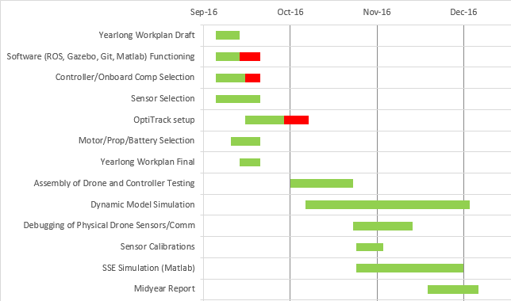
Current Progress - Fall semester Gantt chart

Slide 45
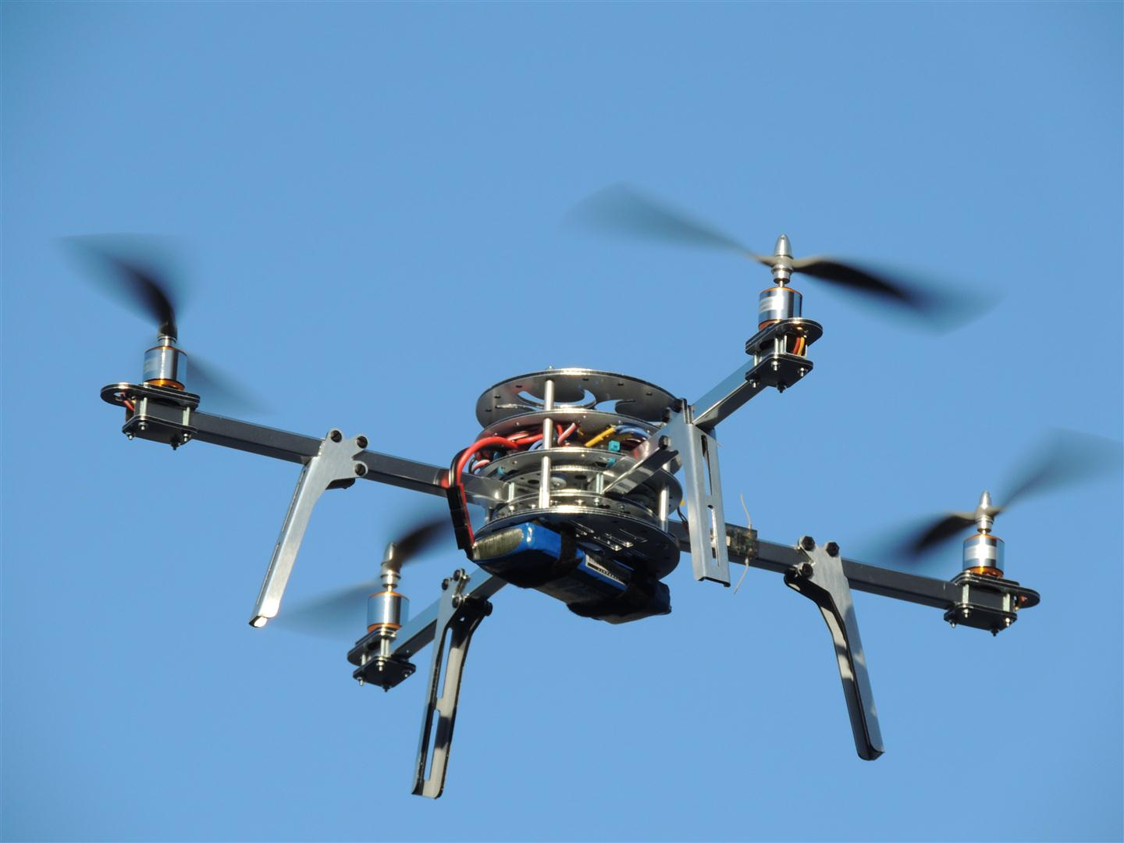
Questions?
http://technozion.org/tz15/home/events/quadcopter

Slide 46
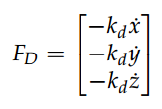
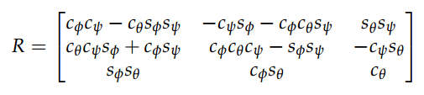
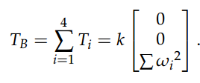
Linear Motion
Drag Force
Rotation matrix for relating body frame to inertial frame
Thrust vector in body frame
http://andrew.gibiansky.com/downloads/pdf/Quadcopter%20Dynamics,%20Simulation,%20and%20Control.pdf

Slide 47
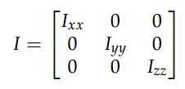
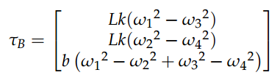
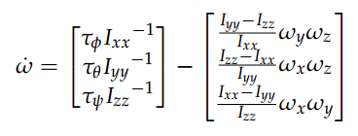
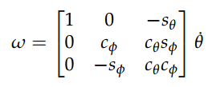
Rotational Motion
Inertia matrix
Torques in the body frame
Angular velocity in body frame
Rotation matrix for relating body frame to inertial frame for rotational motion
http://andrew.gibiansky.com/downloads/pdf/Quadcopter%20Dynamics,%20Simulation,%20and%20Control.pdf

